Slide 1
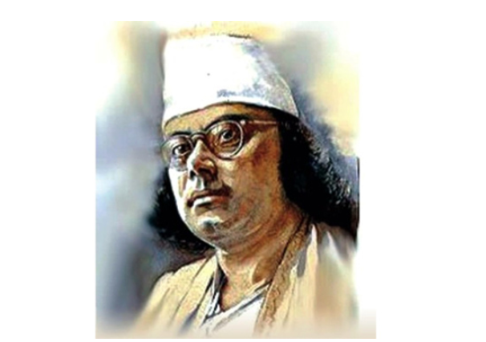




Slide 2


Slide 3




Slide 4


Slide 5



Slide 6
Bengali Music Genre
Rabindra Sangeet
Nazrul Sangeet
Lalon Geeti
Adhunik
Band
Hip Hop

